Slide 1
Predicting Energy Threshold Placement in Photon Counting Computed Tomography
Jacob Aubrey
20-Feb-2025

Slide 2
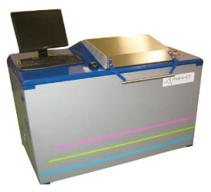
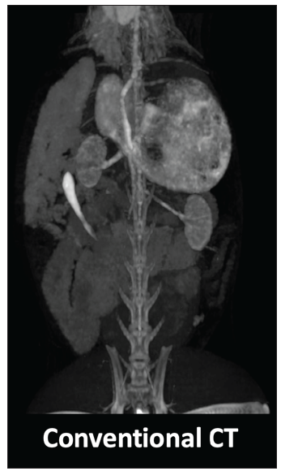
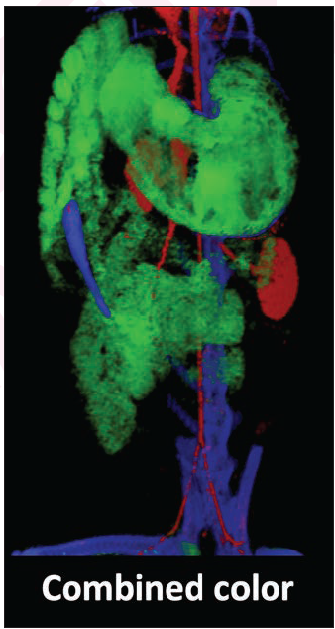
New X-ray CT Technology: Photon Counting Detectors
Allows for seeing in “color”.
RPI has a small prototype on campus capable of scanning small objects and small animals like rats and mice.
Protocol development needed.

Slide 3
Can input parameters predict protocol performance success?
I have a dataset containing 35 different protocols and their respective outcomes (predicted concentration).
I want to create a model with this experimental data that allows a photon counting CT user to be able to test the theoretical performance success of a proposed protocol before testing it on the actual x-ray scanner.

Slide 4
Proposed Model Methods
I have many inputs (i.e. I have many predictors)
I will perform pairwise analyses of each predictor to see if any contain redundant information.
For any redundant pair, I will eliminate one of the predictors.
Then, I will use PCA to reduce the number of independent predictors even further.
Lastly, I will use linear regression to generate a predictive model.

